Slide 1
Advance CSS Selector

Slide 2
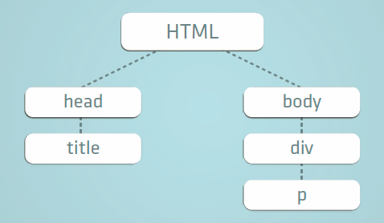
The Document Tree

Slide 3
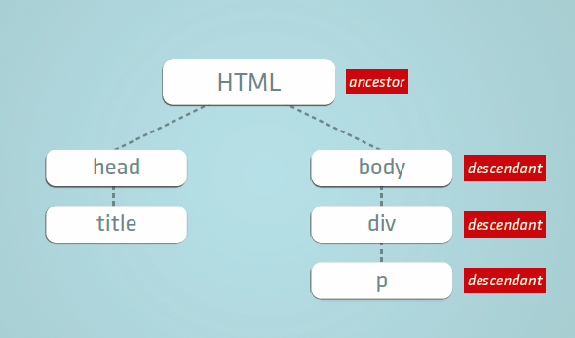
Relationships
parent
child
sibling
sibling

Slide 4
More CSS Selectors
All h1,h2 and h3
Grouping selectors
For example:
Descendant selector
For example:
h1,h2,h3 { text-align:center }
header h1 { line-height:2em }
h1 under the element
with header

Slide 5
Types of CSS Selector
Direct Child Selector
The immediate child of an element
For example:
section > h1 { text-decoration: underline }
all h1 directly under a section will be underlined

Slide 6
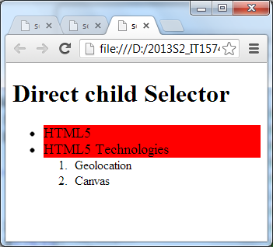
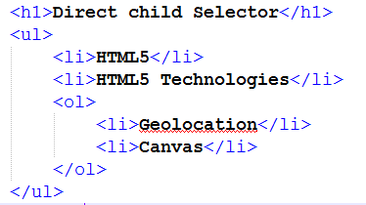
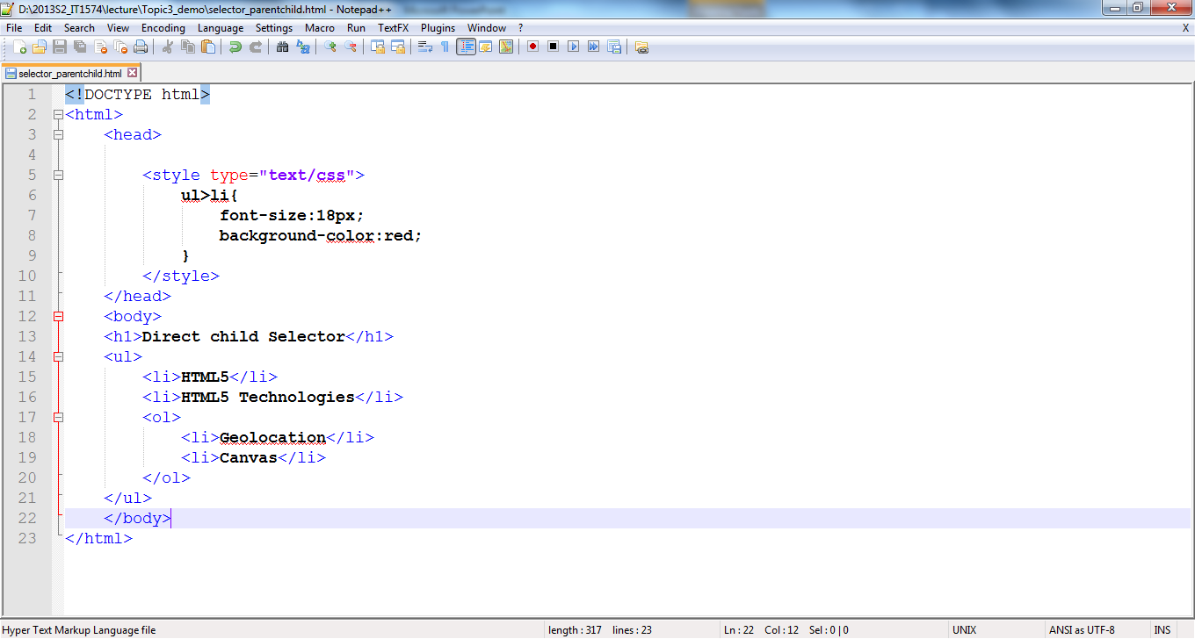
More CSS Selectors
Direct children selector
Syntax:
parent>child{}
Example:
Notes:
Demo using selector_parentchild.html

Slide 7
Types of CSS Selector
Attribute Selector
The element with a particular attribute
For example:
td[colspan]: { background-color:blue }
all table cell with colspan attribute will have blue as the background color

Slide 8
More CSS Selectors
Universal selector – select all the elements
Syntax: * {}
Example : * { margin : 0; padding : 0; }

Slide 9
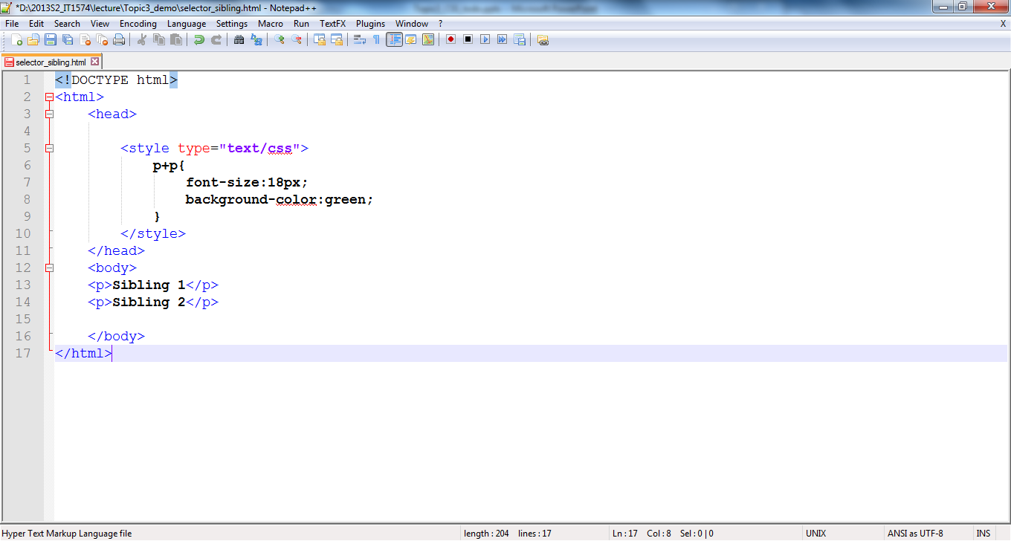
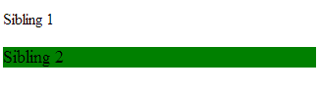
More CSS Selectors
Direct sibling selector
Syntax:
sibling+sibling{}
Example:
Notes:
Demo using selector_parentchild.html

Slide 10
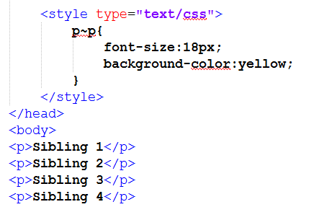
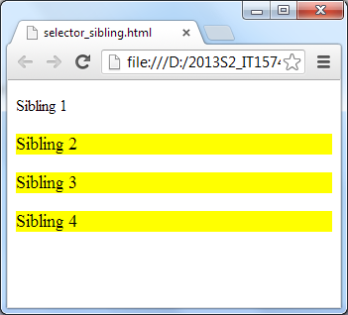
More CSS Selectors
Any sibling selector
Syntax:
sibling~sibling{}
Example:
Notes:
Demo using selector_parentchild.html
http://www.w3schools.com/cssref/tryit.asp?filename=trycss3_gen_sibling

Slide 11
Pseudo-class Selector
Pseudo-class Selectors :
:link{ }
:visited{}
:hover{}
:active{}
:first-child{}
:last-child{}
:nth-child{}
:first-letter{}
Notes:
https://developer.mozilla.org/en-US/docs/Web/Guide/CSS/Getting_started/Selectors

Slide 12
Pseudo-class Selector
first-letter Selector
The first letter of an element
For example:
p:first-letter { font-size:1.5em }
First letter of all paragraphs be of bigger size

Slide 13
Pseudo-class Selector
first-child Selector
The first child of an element
For example:
p:first-child { font-style: italic }
All paragraphs which is the first child of their parents, font style is in italic.

Slide 14
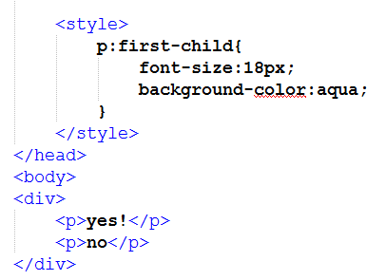
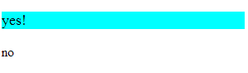
Example:
:first-child{}
select the specified selector, only if it is the first child of its parent
Example :

Slide 15
Pseudo-class Selector
nth-child(n) Selector
By giving different value to n, select a particular child element based on its position relative to its siblings within a parent element.
n can have value of number (e.g. 1, 2), or even or odd
For example:
tr:nth-child(even) { background-color: blue }

Slide 16
Pseudo-class Selector
Styling hyperlink
a { text-decoration: none; } /* no underline*/
a:link {color: #FF0000} /* unvisited link */
a:visited {color: #00FF00} /* visited link */
a:hover {color: #FF00FF} /* mouse over link */ a:active {color: #0000FF} /* selected link */
Notes:
https://developer.mozilla.org/en-US/docs/Web/Guide/CSS/Getting_started/Selectors

Slide 17
Other CSS Selectors
https://developer.mozilla.org/en-US/docs/Web/CSS/CSS_Selectors
https://code.tutsplus.com/tutorials/the-30-css-selectors-you-must-memorize--net-16048

Slide 18
CSS specificity & priority

Slide 19
CSS inheritance
Child elements inherit CSS properties from Parent element
For example:
body {
color:blue;
}
all elements under the body will be set to blue

Slide 20
CSS Specificity
However, CSS specificity determine which CSS property to be applied to an element
For example
body {
color:blue;
}
p {
color:red;
}
All paragraphs will be in red instead of blue

Slide 21
CSS Specificity
Browsers decide which CSS property values are the most relevant to an element and, therefore, will be applied.
directly targeted element will always take precedence over rules which an element inherits from its ancestor
For example:
p {
text-align:left;
}
.right {
text-align:right;
}

Slide 22
CSS Specificity
Inline styles added to an element (e.g., style="font-weight:bold") always overwrite any styles in external stylesheets, and thus can be thought of as having the highest specificity.
In case of same specificity, the most recent takes the precedence
Specificity calculator: https://specificity.keegan.st/
Selector | Specificity
Type selectors (e.g., h1) and pseudo-elements (e.g., :before) | 0
Class selectors (e.g., .example), attributes selectors (e.g., [type="radio"]) and pseudo-classes (e.g., :hover) | 1
ID selectors (e.g., #example) | 2

Slide 23
Reset Browser Styles
Why?
helps to reduce browser inconsistencies in things like default line heights, margins, paddings and font sizes of headings; all these properties could affect the styling of page layout.
Help in writing the subsequent CSS rules; as this ensures styles written are on top of a consistent base
How?
For example: Zero out the default margins and padding that the browsers apply
Example by Eric Meyer

